Slide 1
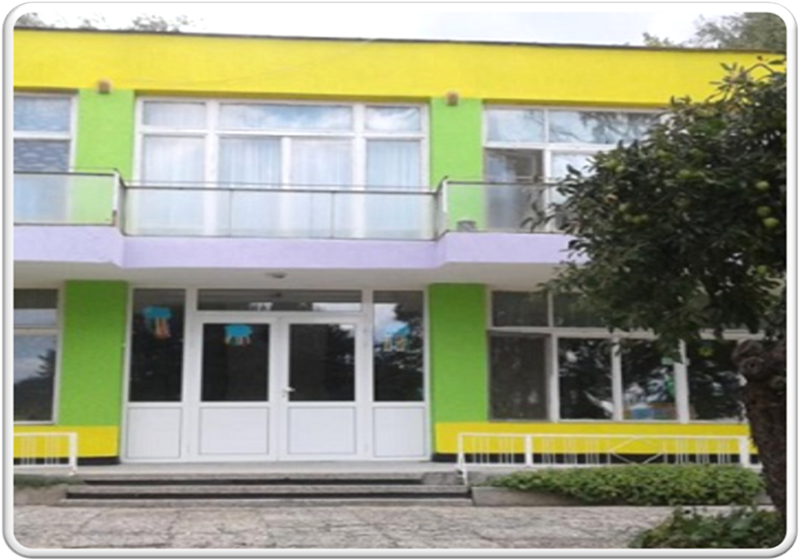
First of June 17
Kindergarten
Dobrich town

Slide 2
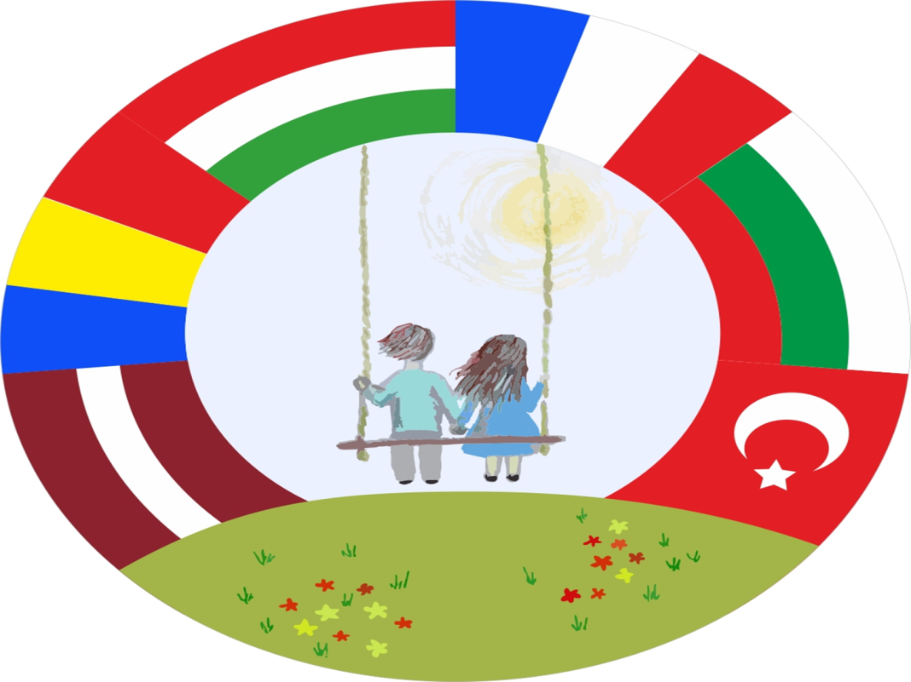
MASCOTS
Place to be…to live in harmony

Slide 3
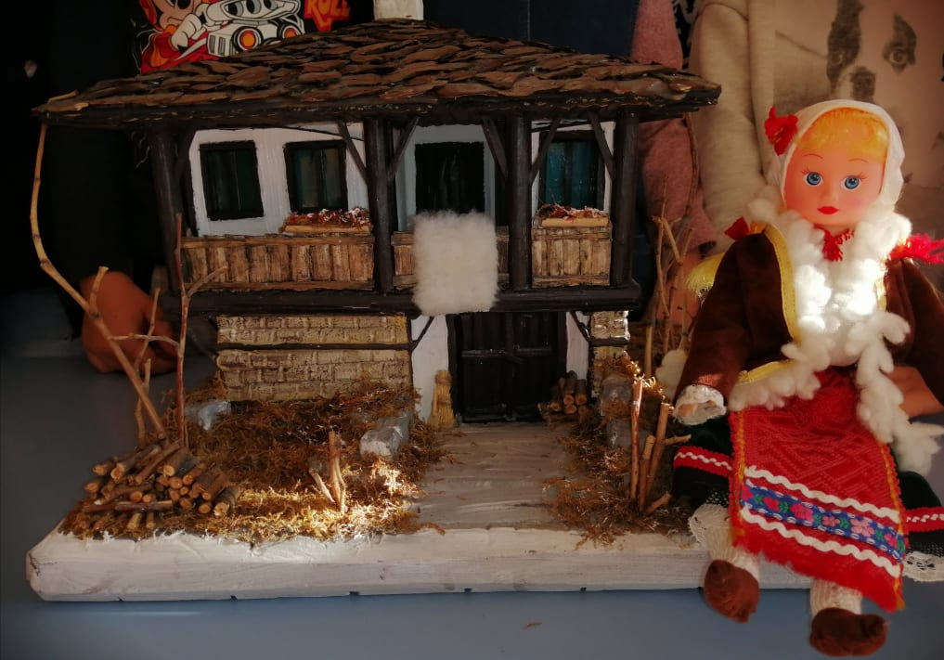
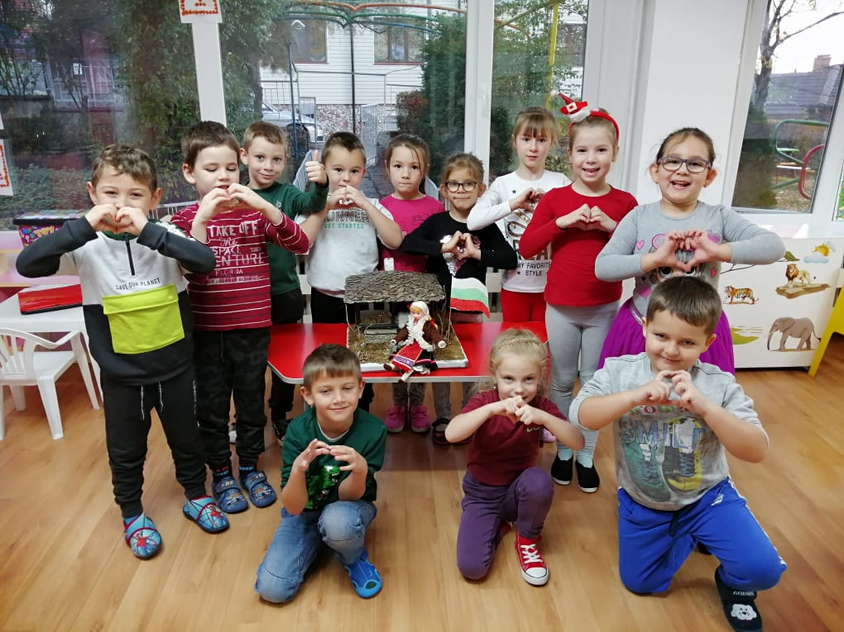
THE GOLDEN GIRL
From Bulgaria

Slide 4
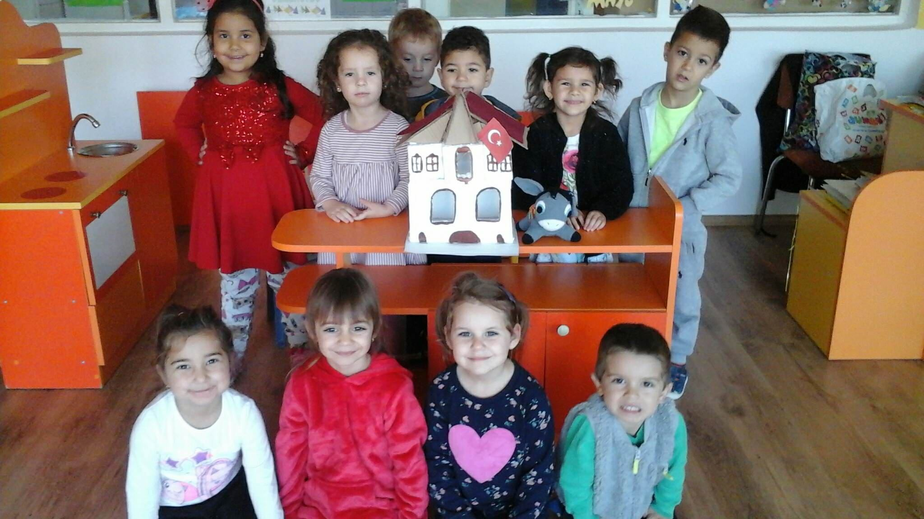
Who will sell the pickle?
Karakachan and turkish tale

Slide 5
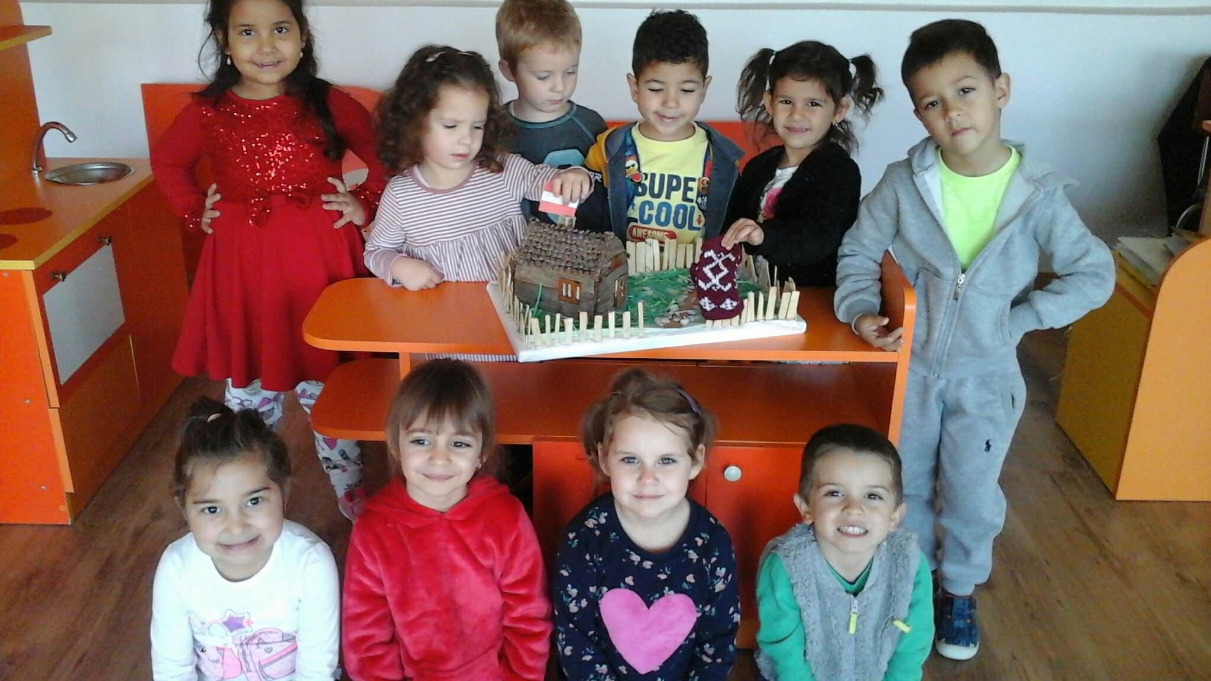
OLD MAN MITTEN- LATVIAN TALE

Slide 6
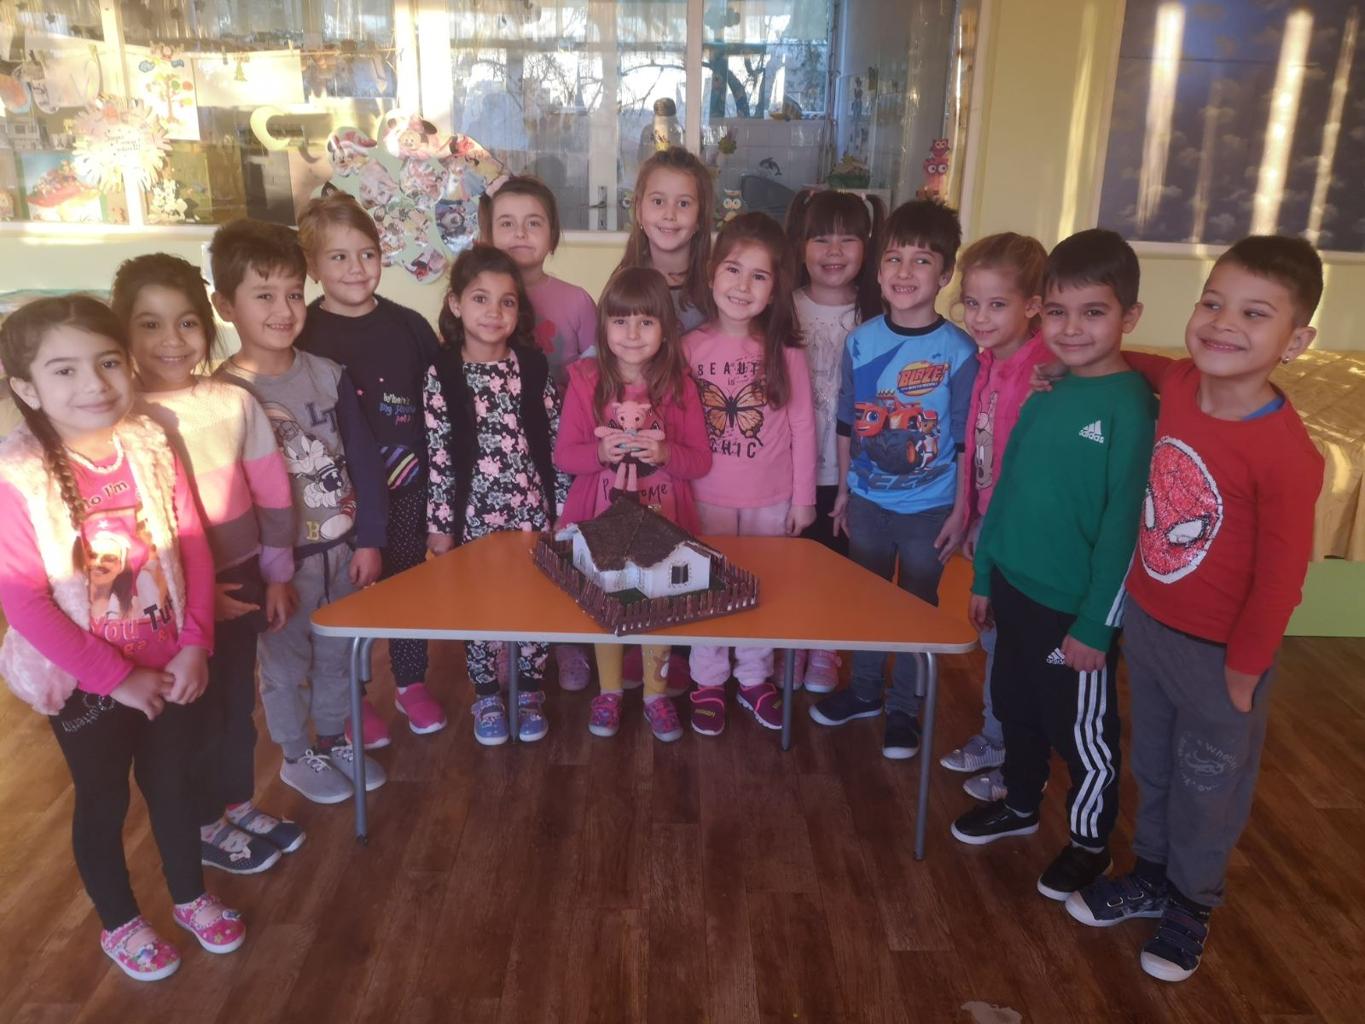
The little pig- Hungarian tale

Slide 7
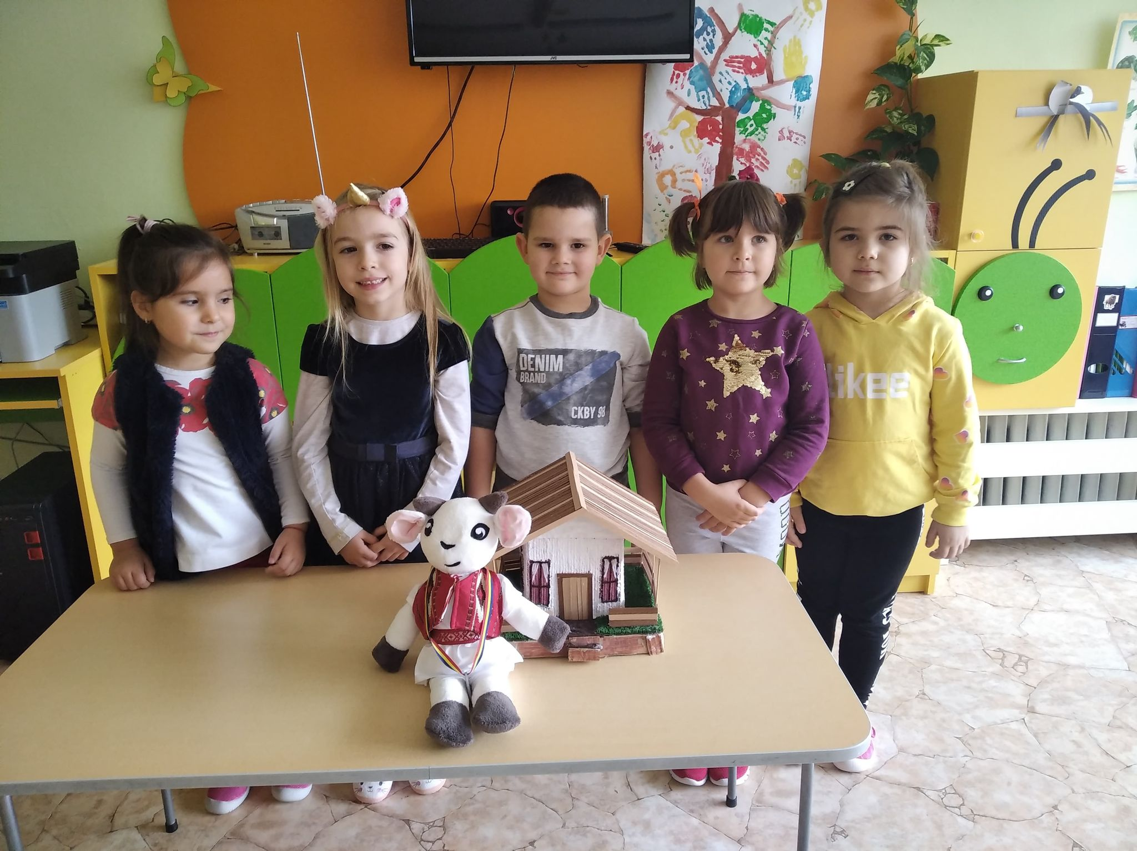
The Baby Goat-Rumanian tale

Slide 8
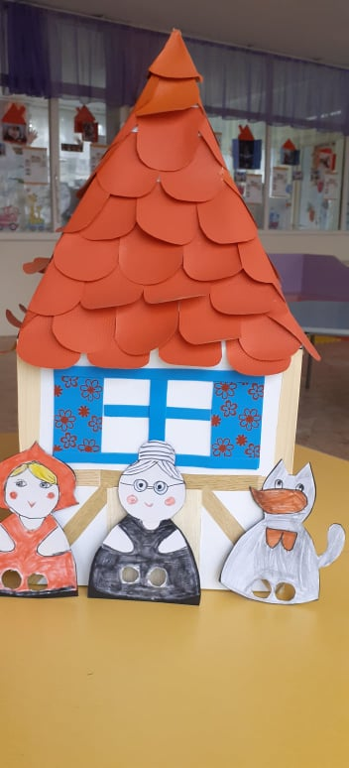
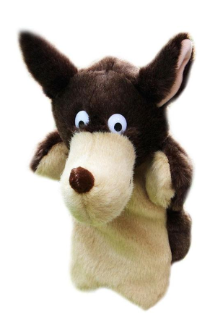
The Wolf in French Tale

Slide 9
THANK YOU!!!
By G.Penkova

